Slide 1
Applied Data Science Portfolio Milestone
By: Taylor Moorman

Slide 2
Outline
About Me
Professional Experience
Road to Syracuse
Learning Goals 1-7
Looking Back
Towards the Future

Slide 3

About Me
Born and raised in Phoenix, Arizona
Played Ice hockey for 14 years
Lifelong athlete
Bodybuilding
PowerLifting
Nutrition and fitness
Getting married in November

Slide 4


Professional Experience
Graduated from Arizona State University in May 2018
B.S. Entrepreneurship
B.S. Computer Info. Systems
B.S. Business Data Analytics
Currently work as a Business Intelligence Analyst
Data Warehousing
Data Visualizations
Predictive Modeling

Slide 5
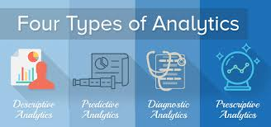

Road to Syracuse
During Junior year of undergrad, realized love for analytics
Knew graduate school was a possibility
Researched how it can accelerate career
Touched on so many topics in undergrad, wanted chance to dive deeper

Slide 6


Learning Goal #1
IST 652 Scripting for Data Analysis Final Project
Predicting the outcomes of UFC fights
Written in Python
Full data lifecycle
Gathering requirements
Collecting data
Cleaning and transforming data
Drawing insights from Data viz
Training and testing models
Presenting results

Slide 7
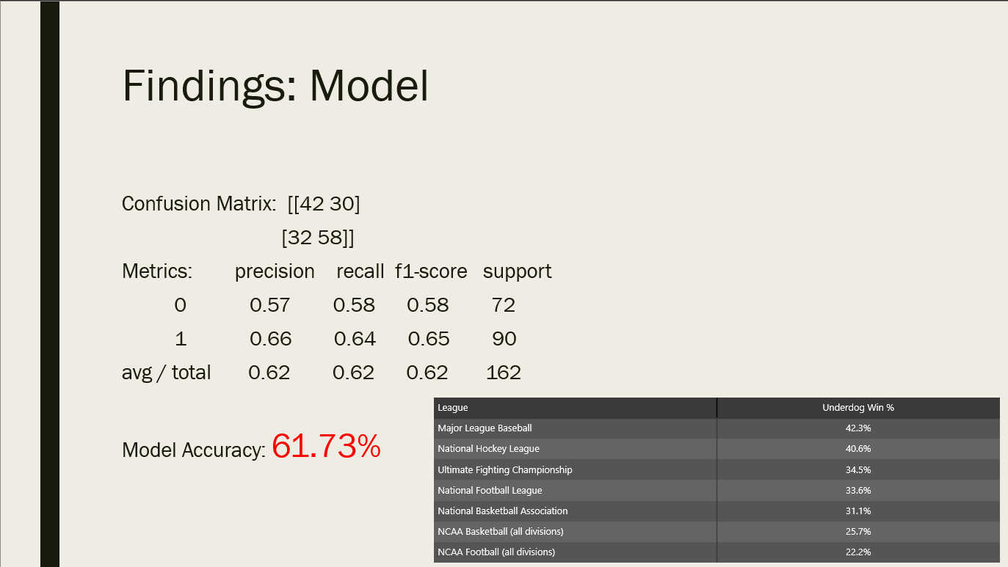
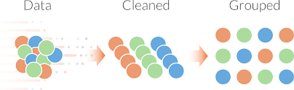
Learning Goal #2
IST 652 Scripting for Data Analysis Final Project
Predicting the outcomes of UFC fights
Had to gather 3 different disparate data sets
Cleaned all three
Joined / appended all three together
Transformed columns, discretized features, bucketed numbers

Slide 8
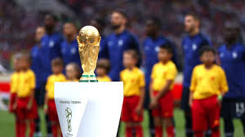
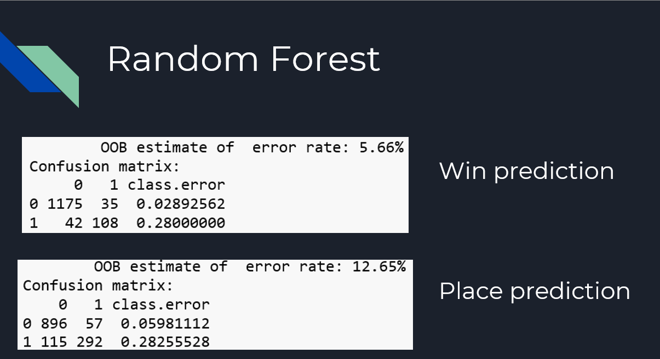
Learning Goal #3
IST 707 Data Analytics Final Project
Predicting / Analyzing the Economic Impacts of the FIFA World Cup
Written in R
Identified patterns in winners and losers
Saw statistical relevance of hosting the event on winning and placing in tournament
Discovered Zero-sum acitivity of hosting event

Slide 9

Learning Goal #4
IST 707 Data Analytics Final Project
Predicting / Analyzing the Economic Impacts of the FIFA World Cup
Originally planned to predict whether or not a host country would come out ahead financially
Did not have enough total economic data from host countries
Could not find exact figures to pinpoint investment into hosting games
Data we did have could only relate to financial impact of winning

Slide 10

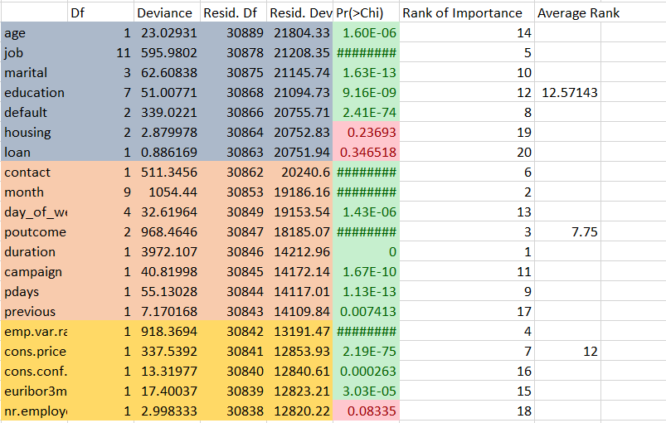
Learning Goal #5
MAR 653 Marketing Analytics Final Project
Predicting whether customers would invest in a bank given a variety of factors
Done in conjunction of R and Excel
Found a number of statistically relevant factors
Had to form these findings into business related actions
Had to synthesize these actions and present them to “the business”
Every finding had to make business sense
Developed a plan of action for implementation

Slide 11
Learning Goal #6
IST 707 Data Analytics Final Project
Predicting / Analyzing the Economic Impacts of the FIFA World Cup
Was required to do a 20 minute presentation of our findings
Had to explain analysis and findings in an intuitive fashion
Staying on point while covering enough to get point across

Slide 12

Learning Goal #7
IST 623 Introduction to Data Security Final Project
Presentation on the Marriott-Starwood data breach
Had to fully research the breach
How it happened
When it happened
Who was affected
How the attackers got in
What could have been
done to prevent it
What are the fallouts/repercussions

Slide 13


Looking Back
Time in the program has been challenging
Late nights and some mental breakdowns
More learning in a year than I ever could’ve imagined
Some of the best teachers I have had
So much confidence gained

Slide 14

Into the Future
I hope to expand my current position to include more of what I have learned
Ultimately strive to become a data scientist
Building predictive models
Owning the data for a corporation
Being a subject matter expert
Diving into sports analytics specifically Hockey

Slide 15
Thank you!

